Slide 2



The OMS Solutions Bakery
How to build a custom OMS solution in 60 minutes
Marcel Zehner | Corporate Ambassador itnetX
Microsoft Regional Director (RD)
Microsoft Most Valuable Professional (MVP)
marcelzehner | @marcelzehner

Slide 3
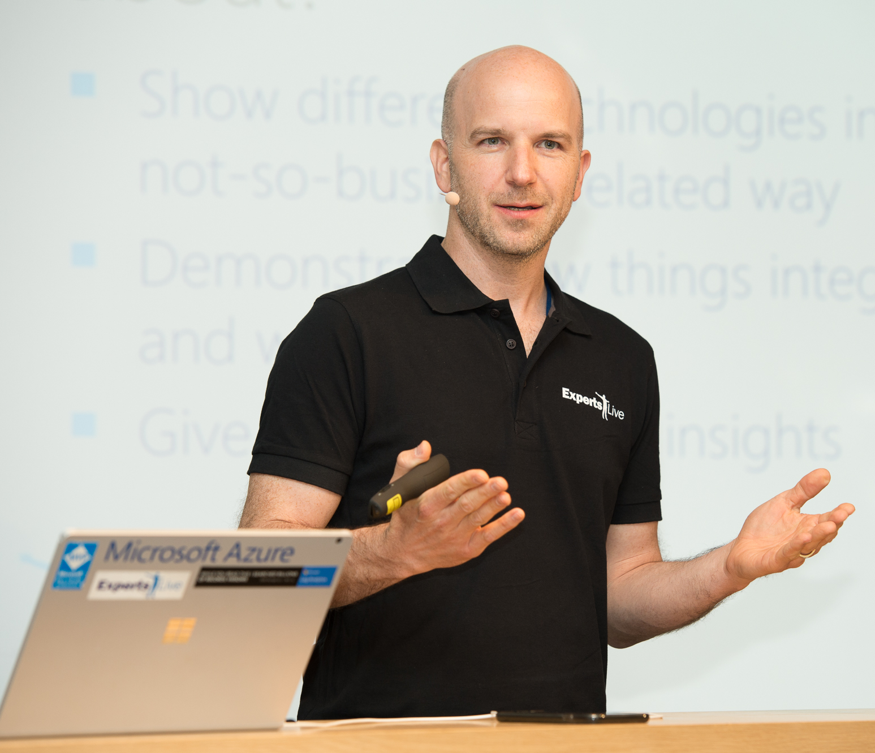
About Me
itnetX Global Alliance
Switzerland
Microsoft MVP & RD
Microsoft Azure addict
IT & tech geek
Speaker & blogger
Community supporter
World traveller
Group fitness fanatic
Notes:
About me
Why this session

Slide 4
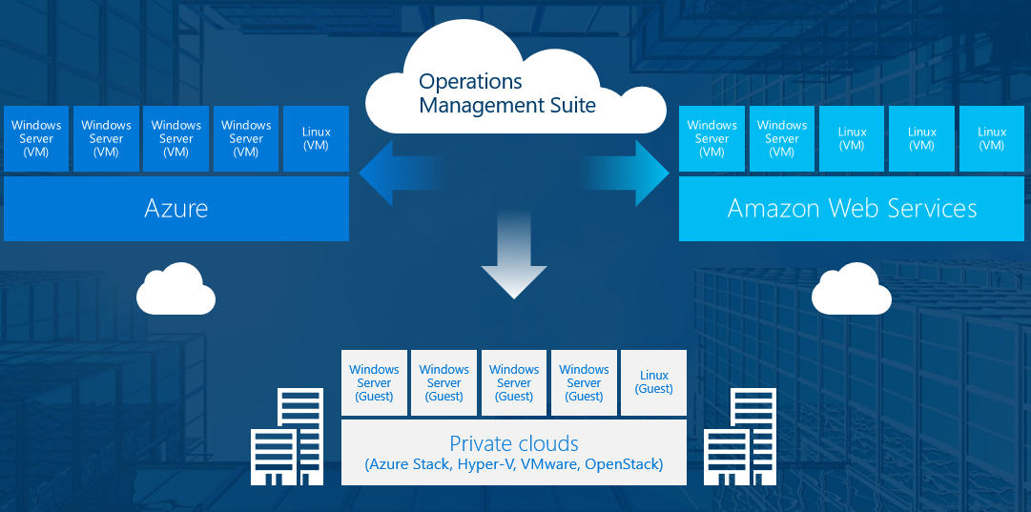
Quick OMS overview
Hybrid Cloud Management
Azure Log Analytics
Azure Automation
Azure Security Center
Azure Recovery Services
Extensibility
Can be extended by adding solutions to the log analytics workspace

Slide 5
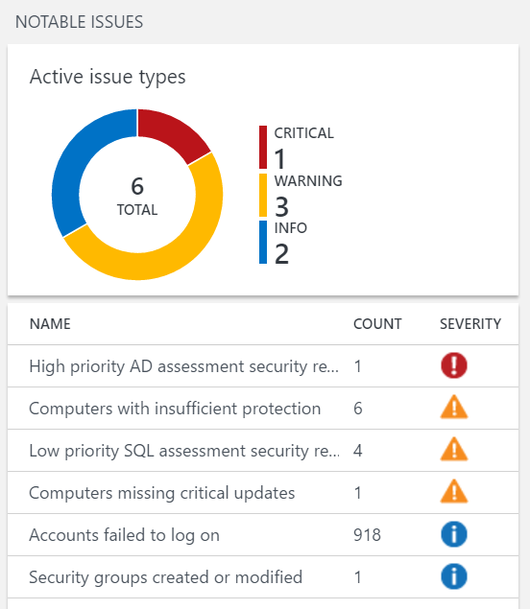
What’s in a solution?
Bundled, grouped resources to extend the functionality
Gallery/Marketplace
Custom
A solution CAN contain …
a mechanism to collect specific data
queries to extract information from the collected data
views to aggregate and visualize data
alerts for notifications and remediation

Slide 6
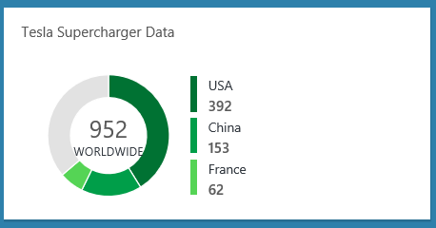
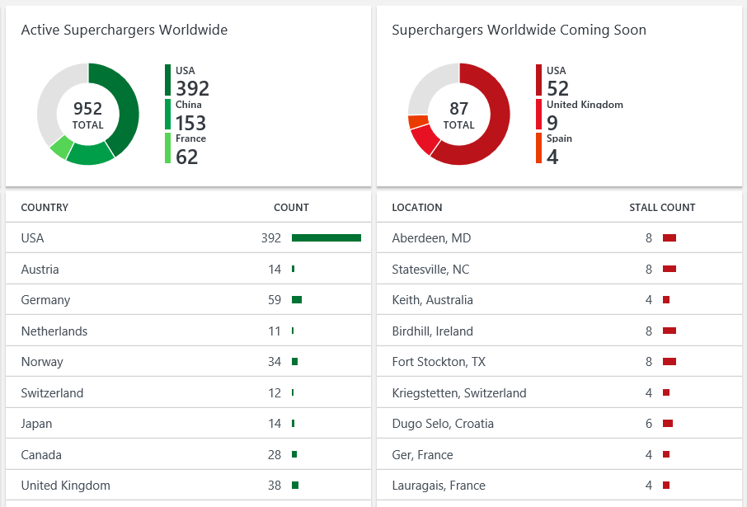
No solution for your workload?

Slide 7
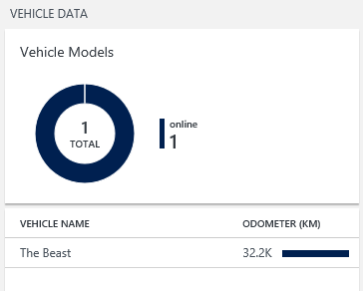
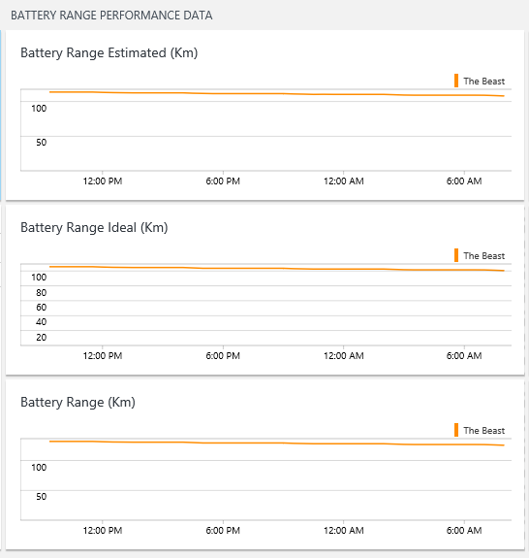
No solution for your workload?

Slide 8

Recipe

Slide 9
What is the goal of the solution?
Ask yourself ...
Who are the consumers of the solution?
What benefit do they expect from the solution?
What data needs to be collected?
How can the data be presented in an easy-to-understand way?

Slide 10
How will the data be collected?
Depends on the source system
Possible collection methods
Web service
API/SDK
Log files
Etc.

Slide 11
How is the data ingested into OMS?
Submit data to the HTTP Data Collector API
Data needs to be in JSON format
Application
Cloud
Data Collection Process
API
Log Analytics

Slide 12
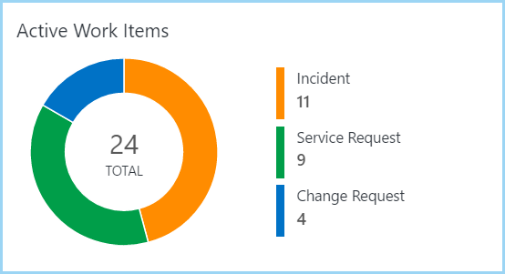
My recipe for this demo 1/2
Visualize tickets from System Center Service Manager
Stakeholders
Operations team, team leaders and managers
Goals
Get immediate overview of active tickets together with other operations insights
See most important tickets immediately
Escalated tickets
SLO warnings/breaches

Slide 13
My recipe for this demo 2/2
Data will be collected from Service Manager CMDB
PowerShell collection script
Schedules with Windows Task Scheduler to run every hour
Collection script will run on a regular basis (every hour)
View to visualize the collected data

Slide 14

Bake

Slide 15
Collect data
Create the collection script
PowerShell or equivalent
Schedule
Scheduled task, SMA, Azure Automation, Windows Service etc.
Triggered based on a specific event or happening in the app
If properties in the source system has no value, they are not created on the log analytics event
Problem when grouping events by field value
Example: “Classification” of an Incident could be empty
Workaround: Check during collection and use “not set” value (or similar)

Slide 16
Prepare data for ingestion
Example with PowerShell
Collect Data
Create a PowerShell object for every active ticket
Add ticket property values
Pipe to “ConvertTo-Json”
[
{
“Title”: “Server 2 has a physical disk failure”,
“Escalated”: true,
“Classification”: ”Server Hardware”,
“AffectedUser”: “Jack Jones”
},
{
“Title”: "Cannot print from desktop”,
“Escalated”: false,
“Classification”: “Not Set”,
“AffectedUser”: “Megan Masterson”
}
]

Slide 17
Ingest data
Use 2 functions provided by Microsoft
Build authorization signature
Ingest data
Option: Use PowerShell module «OMSIngestionAPI»
https://docs.microsoft.com/en-us/azure/log-analytics/log-analytics-data-collector-api

Slide 18
Query data and create alerts
Create queries
Easy-to-learn query language
Log Search or Advanced Analytics portal
Throw alerts
When specific events are collected/discovered
Send mail, trigger webhooks or runbooks, use ITSM connector

Slide 19
Visualize data
Create views
Use view designer together with your queries
Main tile
Specific views (drill down)
Use data from Power BI
Create Power Query (M language)
Use Power BI Desktop to access data
Design report, then publish to Power BI Service
Create Power BI reports/dashboards

Slide 20
Solution development best practices
Use versioning and source control
Visual Studio Online
TFS
Git
Etc.
Test your collection script inside out
Include error handling
Check if the ingested data is correct
Check views (special focus: selected object queries)

Slide 21
My recipe for this demo
Create a PowerShell script that collects tickets from System Center Service Manager
Implement PowerShell script as a scheduled task
Create queries
Create view with the view designer
Create alerts
Create query for Power BI

Slide 22

Live Demo «Bake»

Slide 23

Deliver

Slide 24
Deployment
The full solution has multiple components
OMS Log Analytics workspace
OMS Dashboard view
Collection script
Alerts, queries and more …
Use Azure Resource Manager (ARM) for deployment
Declarative approach
Deliver all components of the solution together (bundled)

Slide 25
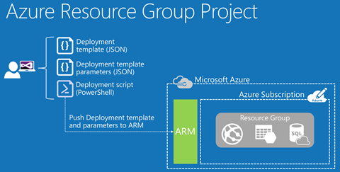
Azure Resource Manager (ARM)
Set of resource providers
Accessed through APIs to manage Azure resources
Declarative provisioning & lifecycle management
Use appropriate tool to create JSON file
Visual Studio with Azure SDK
Visual Studio Code
Use Azure quick start templates on Github to start your journey

Slide 26
Deploy ARM Templates
Deploy using Visual Studio (with Azure SDK)
Deploy using PowerShell
New-AzureRMResourceGroupDeployment
Azure CLI
azure group deployment create
Use template deployment in Azure Portal
Publish to Azure Marketplace

Slide 27
My recipe for this demo
Create an ARM template
Log analytics workspace
1 view
2 queries
Create solution
Deploy whole solution

Slide 28
Live Demo «Deliver»

Slide 29
Enjoy

Slide 30
Enjoy
Enjoy your solution
Ask consumers for feedback
Improve the solution over and over again
Continuous improvement process

Slide 31

Recap

Slide 32
OMS Solution Lifecycle
Recipe
Bake
Deliver
Enjoy
Continuous
Improvement

Slide 33
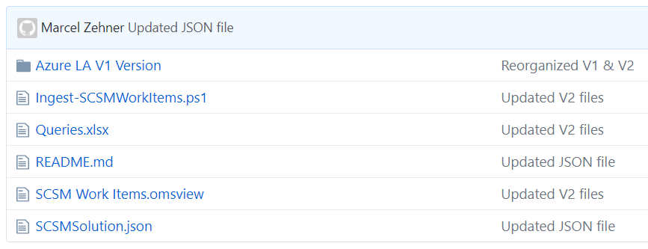
Download Example Files
github.com/MarcelZehner/OMSServiceManagerSolution
Collection script
Excel file with queries
Exported OMS view
ARM template to deploy the solution

Slide 34
The OMS Solutions Bakery
How to build a custom OMS solution in 60 minutes
Marcel Zehner | Corporate Ambassador itnetX
Microsoft Regional Director (RD)
Microsoft Most Valuable Professional (MVP)
marcelzehner | @marcelzehner

